Slide 1
Introduction to Probability

Slide 2
Suggested Books
Probability and Statistics for Computer Scientists, 2nd Edition
https://learning.oreilly.com/library/view/probability-and-statistics/9781439875919/
Essential Math for Data Science:
https://learning.oreilly.com/library/view/essential-math-for/9781098102920/

Slide 3
What is the theory of probability ?
Probability is a measure of how likely an event will occur.
In other words, “probability” is a ration of:
Desired Outcomes/ Total Outcomes.
Example:
While tossing a coin, you can get two possible outcomes either get a Head or, a Tail. The probability of one of these two situations is, 1/2
While rolling a dice, you can get one of the six possible sides. The probability of getting number “5” is, 1/6.

Slide 4
Terminologies in Probability
Experiment: – are the uncertain situations, which could have multiple outcomes. Whether it rains on a daily basis is an experiment.
Outcome: is the result of a single trial. So, if it rains today, the outcome of today’s trial from the experiment is “It rained”
Event: One or, more outcomes of an experiment. For example, possibility of “2” is a possible outcome (or, event) when you roll a dice.
Sample Space: The entire possible set of outcomes of a random experiment. For example, while rolling a dice 1,2,3,4,5,6 are all possibilities(or, spaces) that can occur from the random experiment.

Slide 5
Example
A tossed die can produce one of 6 possible outcomes: 1 dot through 6 dots. Each outcome is an event. There are other events: observing an even number of dots, an odd number of dots, number of dots less than 3, etc.
A sample space of N possible outcomes yields 2^{N} possible events.

Slide 6
Example 1
If there are 5 communication channels in service, and a channel is selected at random when a telephone call is placed, what is the probability of each channel being selected?
Answer: Each channel has a probability 1/5 = 0.2 of being selected.

Slide 7
Example 2
Two competing software companies are after an important contract. Company A is twice as likely to win this competition as company B. What is the probability of winning the contract for each company A and B?
Answer: The probability to win the contract equals 2/3 for A and 1/3 for B.

Slide 8

Sets
Events are sets of outcomes. Therefore, to learn how to compute probabilities of events, we shall discuss some set operations.

Slide 9
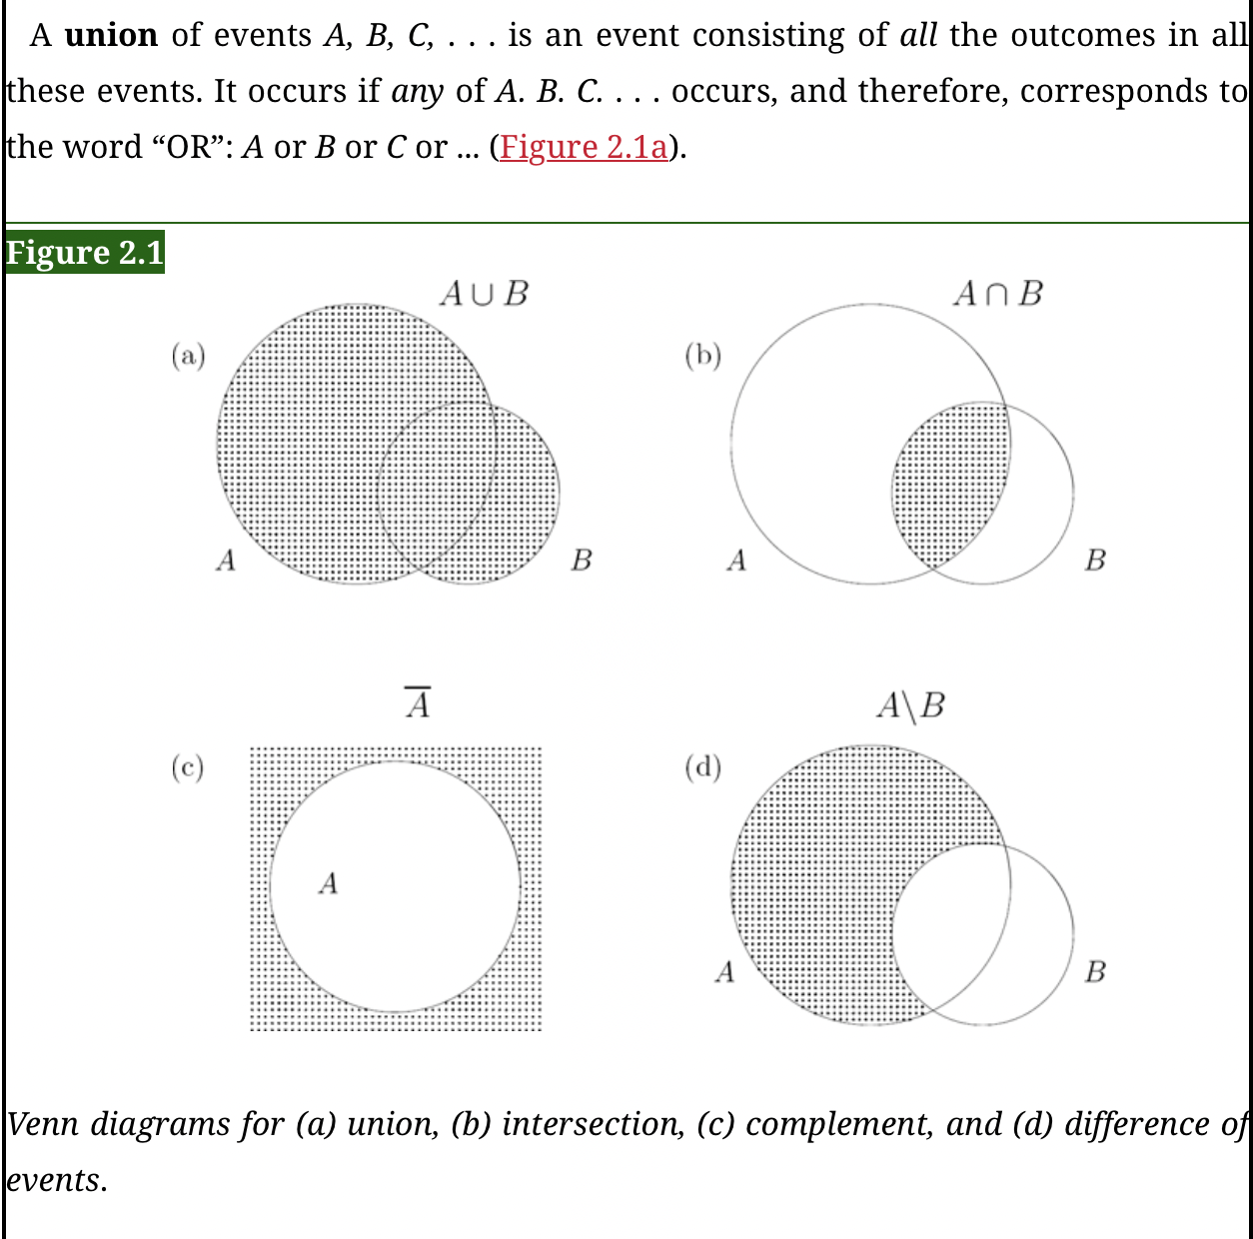

Slide 10
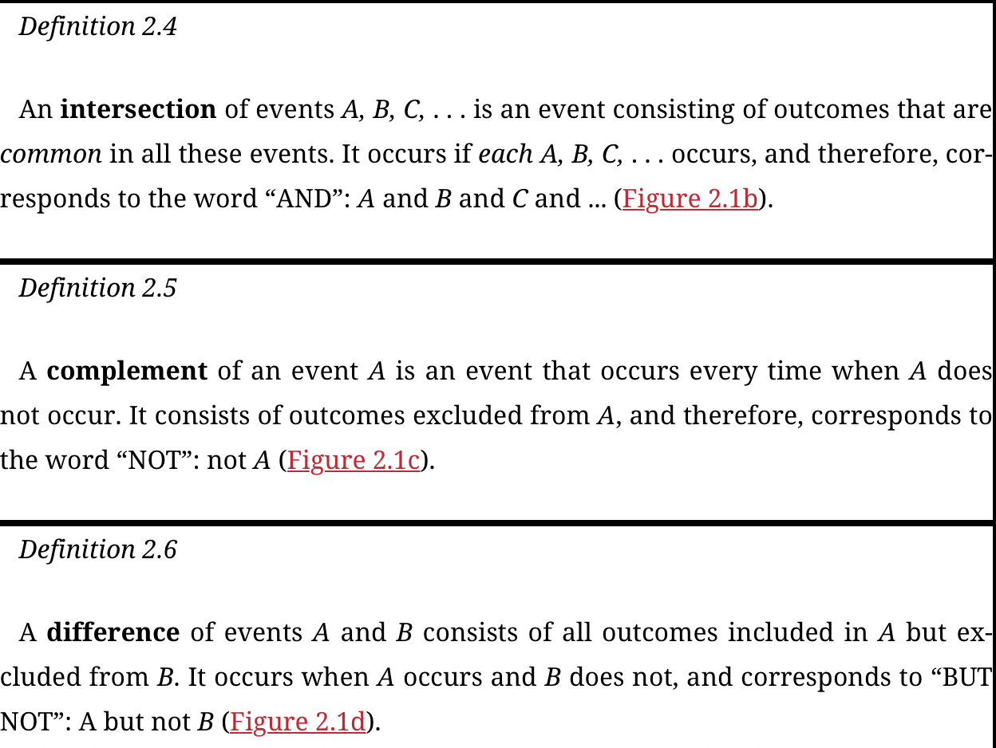

Slide 11
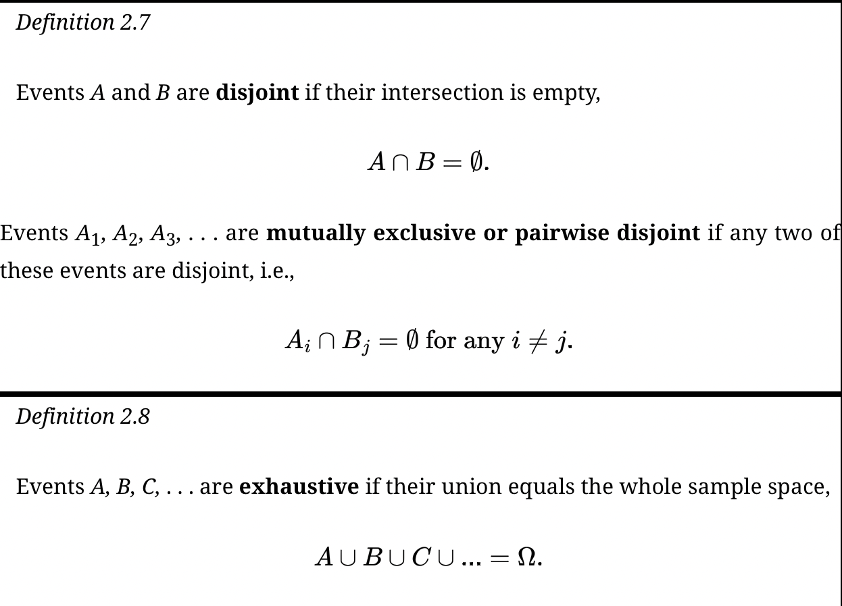

Slide 12
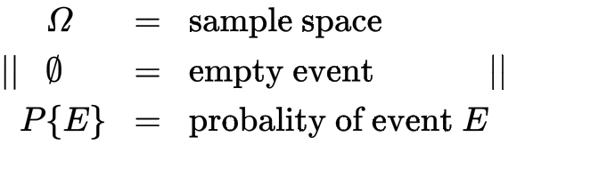

Notation

Slide 13
Important notes about Probability
Probability is about quantifying predictions of events yet to happen.
It is important to note that a probability of an event happening must be strictly between 0% and 100%, or 0.0 and 1.0. Logically, this means the probability of an event not happening is calculated by subtracting the probability of the event from 1.0, which is also called the complement rule.

Slide 14
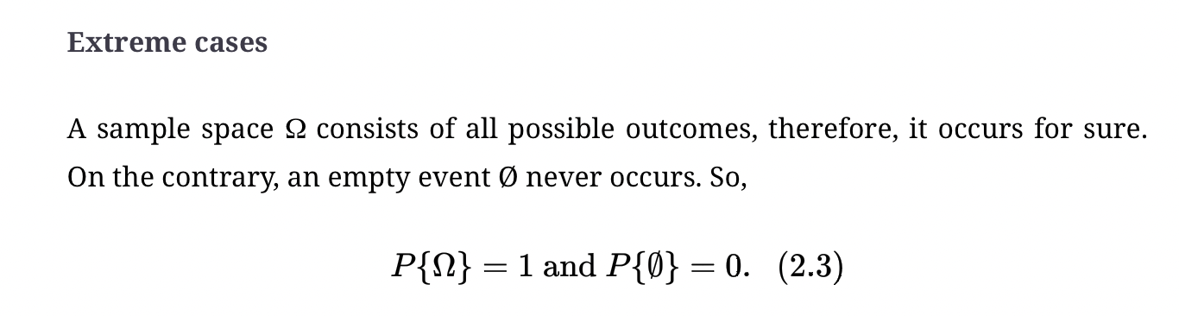

Computing Probabilities of Events Extreme Cases

Slide 15
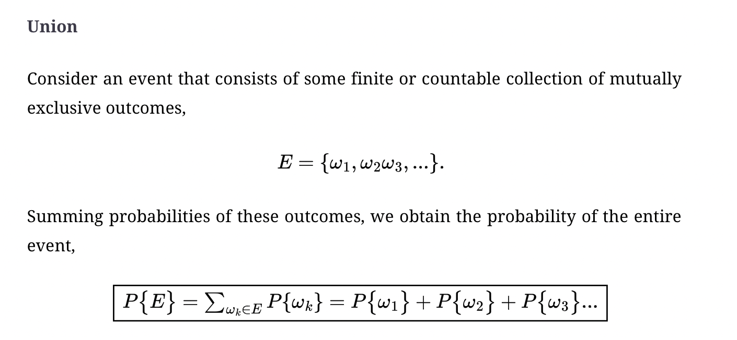
Union

Slide 16
Example
If a job sent to a printer appears first in line with probability 60%, and second in line with probability 30%, then with probability 90% it appears either first or second in line.

Slide 17
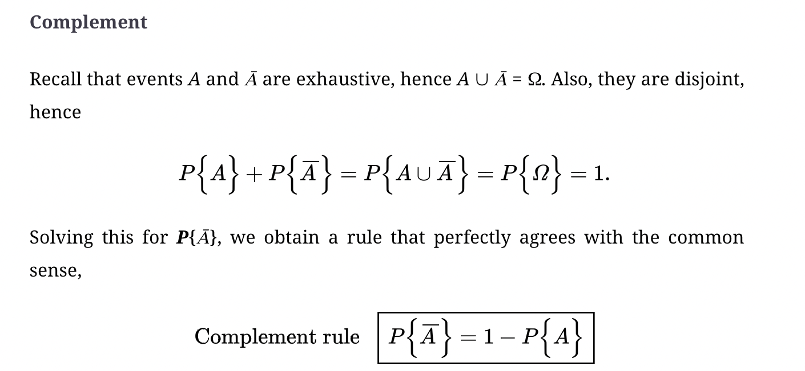
Complement and the complement rule

Slide 18
Example
If a system appears protected against a new computer virus with probability 0.7, then it is exposed to it with probability 1 − 0.7 = 0.3

Slide 19
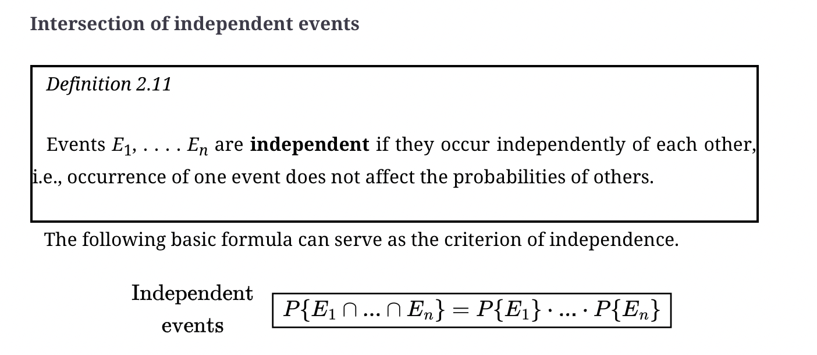
Intersection of independent events

Slide 20
Joint Probabilities
Let’s say you have a fair coin and a fair six-sided die. You want to find the probability of flipping a heads and rolling a 6 on the coin and die, respectively. These are two separate probabilities of two separate events, but we want to find the probability that both events will occur together. This is known as a joint probability.
Think of a joint probability as an AND operator

Slide 21

Example
I want to find the probability of flipping a heads AND rolling a 6. We want both events to happen together, so how do we calculate this probability?
There are two sides on a coin and six sides on the die, so the probability of heads is 1/2 and the probability of six is 1/6. The probability of both events occurring (assuming they are independent, more on this later!) is simply multiplying the two together:

Slide 22
Union Probabilities
What about the probability of getting event A or B? When we deal with OR operations with probabilities, this is known as a union probability.

Slide 23

Example
For example, if I roll one die I cannot simultaneously get a 4 and a 6. I can only get one outcome. Getting the union probability for these cases is easy. I simply add them together. If I want to find the probability of getting a 4 or 6 on a die roll, it is going to be 2/6 = 1/3:

Slide 24
Conditional Probability
The conditional probability of an event is a particular event (B) will occur if an event (A) has occurred.
Conditional Probability is represented as, P(B|A)= P(A ∩ B) / P(A) That implies that, mathematically, A and B are not independent.
Likewise, if we find that, as event (A) will occur if an event (B) has occurred, then
Conditional Probability will be, P(A|B)= P(A ∩ B) / P(B)

Slide 25

Permutations
Possible selections of k distinguishable objects from a set of n are called permutations. When we sample with replacement, each time there are n possible selections, and the total number of permutations is

Slide 26
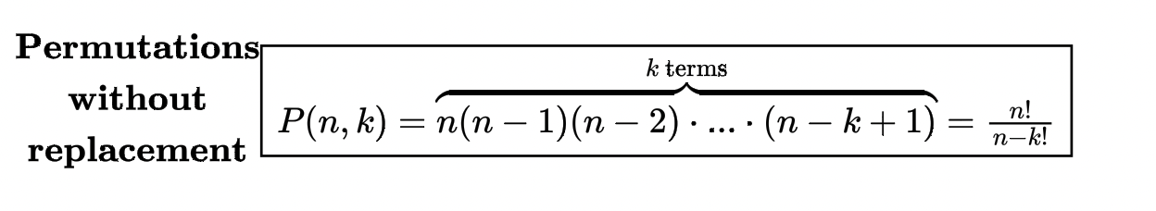
Permutations
During sampling without replacement, the number of possible selections reduces by 1 each time an object is sampled. Therefore, the number of permutations is

Slide 27

Permutations : Example
BREAKING PASSWORDS). From an alphabet consisting of 10 digits, 26 lower-case and 26 capital letters, one can create P_{r}(62, 8) = 218,340,105,584,896 (over 218 trillion) different 8-character passwords. At a speed of 1 million passwords per second, it will take a spy program almost 7 years to try all of them. Thus, on the average, it will guess your password in about 3.5 years.
At this speed, the spy program can test 604,800,000,000 passwords within 1 week. The probability that it guesses your password in 1 week is

Slide 28
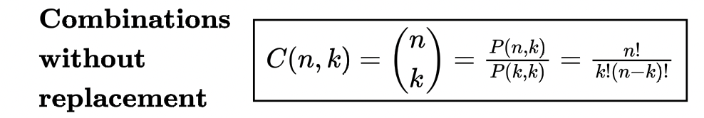
Combinations
Possible selections of k indistinguishable objects from a set of n are called combinations. The number of combinations without replacement is also called “n choose k” and is denoted by C(n, k)
The only difference from P(n, k) is disregarding the order.

Slide 29
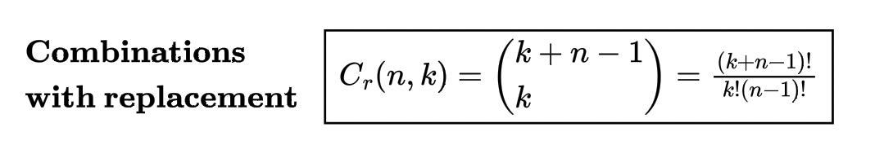
Combinations
For combinations with replacement, the order is not important, and each object may be sampled more than once.

Slide 30

Combinations : Example
An antivirus software reports that 3 folders out of 10 are infected. How many possibilities are there?
Solution. Folders A, B, C and folders C, B, A represent the same outcome, thus, the order is not important. A software clearly detected 3 different folders, thus it is sampling without replacement. The number of possibilities is

Slide 31

Conditional Probability
Assume a fair dice has been rolled, and the event “A” shows odd number outcomes, A= {1, 3, 5} and “B” is an event shows outcome less than or, equal to 3, B= {1, 2, 3}.
The probability of “A” is: 3/6 (Considering 3 is the event over sample size 6)=1/2
However, P(A|B) or, probability of A when B given, is:
(A ∩ B)= {1,3}
So, P(A|B)= P(A ∩ B) / P(B) = 2/3.

Slide 32
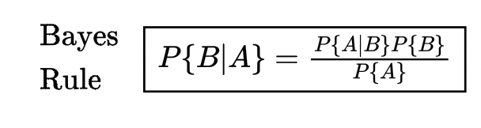
Conditional Probability and Bayes' Theorem

Slide 33
Application of Bayes' Theorem
A study claims that 85% of cancer patients drank coffee.
Let’s first define this as a conditional probability P(Coffee given Cancer) or P(Coffee|Cancer). This represents a probability of people who drink coffee given they have cancer.
Within the United States, let’s compare this to the percentage of people diagnosed with cancer (0.5% according to cancer.gov) and the percentage of people who drink coffee (65% according to statista.com):
P(Coffee)=.65
P(Cancer)=.005

Slide 34
Bayes' Theorem Application
If we are interested in studying whether coffee contributes to cancer, we really are interested in the first conditional probability: the probability of someone having cancer given they are a coffee drinker.
P(Coffee|Cancer)=.85
P(Cancer|Coffee) = ?

Slide 35
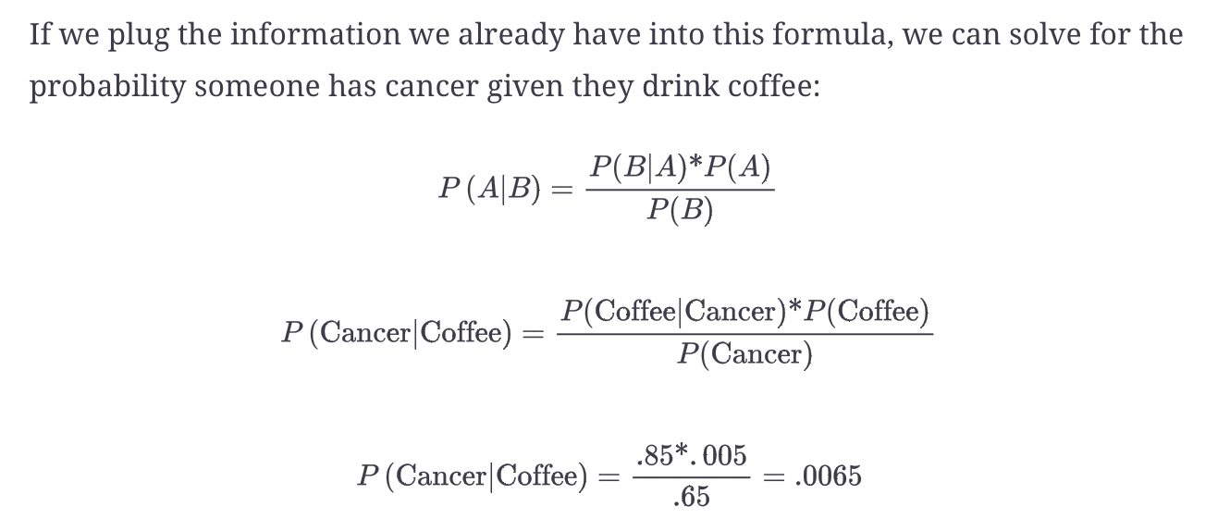

Slide 36
Random Variable
A random variable is a function that assigns a real number to each outcome in a sample space of a random experiment.
If you toss a coin twice, the chances of possible outcomes in the sample space are:
S= {HH, HT, TH, TT}
For a fair coin flipped twice, the number of tails can be 0, 1 or, 2 and this is a random variable.

Slide 37
Random Variable Continued
Sample Space | Number of Tails
(H, H) | 0
(H, T) | 1
(T, H) | 1
(T, T) | 2
No. of Tails | 0 | 1 | 2
Probability | 1/4 | 2/4 | 1/4
***Random variables can be Discrete or Continuous. This example above is a discrete variable

Slide 38
Any questions? Let’s move on to the worksheet

